Slide 1




NEXT GEN EMPLOYABILITY PROGRAM
Creating a future-ready workforce
Team Members
College Name
Student Name :M.N.Ashmitha
Student ID : au960221243009
Arunachala College of Engineering for Women .

Slide 2

CAPSTONE PROJECT SHOWCASE
Project Title
Car Rentals Application with Django Framework
Abstract | Problem Statement | Project Overview | Proposed Solution | Technology Used | Modelling & Results | Conclusion

Slide 3
Abstract In today's fast-paced world, efficient and convenient car rental services are in high demand. This abstract presents the development of a sophisticated car rental application using the Django framework. The application aims to simplify the process of renting vehicles for both customers and rental agencies. Key features of the application include user authentication and authorization, allowing customers to create accounts, manage their profiles, and make reservations. Rental agencies can manage their fleet, update availability, and track reservations seamlessly through the admin interface. The application employs Django's robust ORM (Object-Relational Mapping) to interact with the database, ensuring data integrity and scalability. Additionally, it utilizes Django's built-in forms and validation to streamline the rental process, reducing errors and enhancing user experience. Furthermore, the application integrates payment gateways to facilitate secure online transactions, providing customers with a convenient way to pay for their reservations. Implementing responsive design principles, the application ensures compatibility across various devices, offering a seamless experience on both desktop and mobile platforms.
Source :Naan Mudhalvan

Slide 4
Problem Statement Develop a car rentals application using the Django framework, allowing users to browse, reserve, and manage rental vehicles efficiently, while providing administrators with tools for inventory management and user tracking.
Source Naan Mudhalvan:

Slide 5
Project Overview For a car rentals application developed with the Django framework, the problem overview typically involves understanding the requirements, functionalities, and challenges associated with building such a system. Here's a comprehensive overview: User Roles and Permissions: -Admin -Customers -Employees -Car Inventory Management -Reservation System -User Authentication and Authorization -Payment Integration -Reporting and Analytics -Scalability and Performance
Source : Naan Mudhalvan

Slide 6
Proposed Solution Designing a car rentals application with Django involves several steps and considerations. Here's a high-level overview of the proposed solution: 1.Project Setup: Install Django and create a new project. Set up virtual environment for dependencies management. 2.Database Design: Identify entities: Users, Cars, Bookings, Rentals, Locations, etc. Design database models using Django ORM. Consider relationships between entities (e.g., a User can have multiple Bookings). 3.Authentication and Authorization: Implement user authentication using Django's built-in authentication system or third-party packages like Django. Define user roles and permissions (e.g., admin, customer).
Source : Naan Mudhalvan

Slide 7
4.Car Listings:
Create views to display available cars for rent.
Implement search and filter functionality based on parameters like location, price, car type, etc
Include details about each car, such as model, year, price, availability, etc.
5.Booking and Reservation:
Allow users to book cars for specific dates and times.
Implement a reservation system to prevent double bookings.
Integrate a calendar for users to select rental dates conveniently.
6.Payment Integration:
Integrate a payment gateway (e.g., Stripe, PayPal) for handling rental payments securely.
Ensure proper validation and error handling during the payment process.
7.User Dashboard:
Provide a dashboard for users to manage their bookings, profile, and payment information.
Allow users to view past bookings, upcoming reservations, and rental history.
Source : Naan Mudhalvan

Slide 8
Admin Panel:
Create an admin interface to manage cars, users, bookings, and other application data.
Admins should be able to add/edit/delete cars, manage user accounts, view booking details, etc.
Email Notifications:
Implement email notifications for booking confirmations, reminders, and cancellations.
Use Django's built-in email functionality or third-party services like SendGrid or Amazon SES.
3.Monitoring and Maintenance:
Implement logging and monitoring to track application performance and detect errors.
Schedule regular maintenance tasks like database backups, updates, and security patches.
Source : Naan Mudhalvan

Slide 9


Technology Used
Front-end
Back-end
Source : Naan Mudhalvan

Slide 10
Modelling & Results Certainly! In the context of a car rental application built with Django framework, modeling involves designing the structure of the application's database. This includes defining the types of data entities (such as cars, customers, rentals, etc.) and their relationships. For instance, you would create models for cars with attributes like make, model, year, etc., and models for customers with attributes like name, contact information, etc. These models would be interconnected, reflecting how data relates to each other within the application. Research in this context involves investigating various aspects related to car rentals that can influence the design and functionality of the application. This may include studying user preferences, market trends, competitor analysis, legal requirements, and technological advancements in the car rental industry. Research helps in making informed decisions about features, user experience, pricing strategies, and more, ultimately enhancing the effectiveness and competitiveness of the car rental application.
Source : Naan Mudhalvan

Slide 11
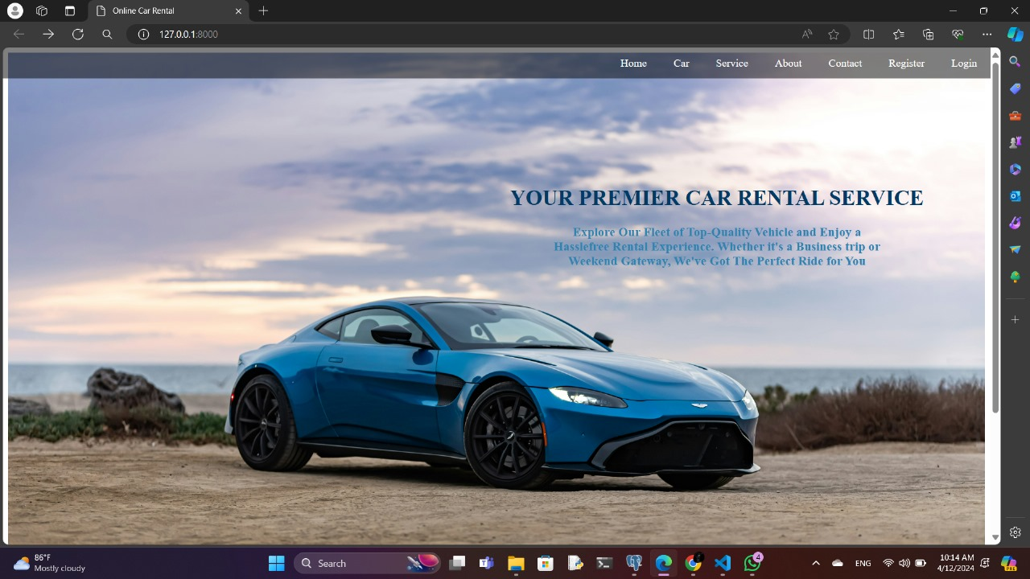
Homepage

Slide 12
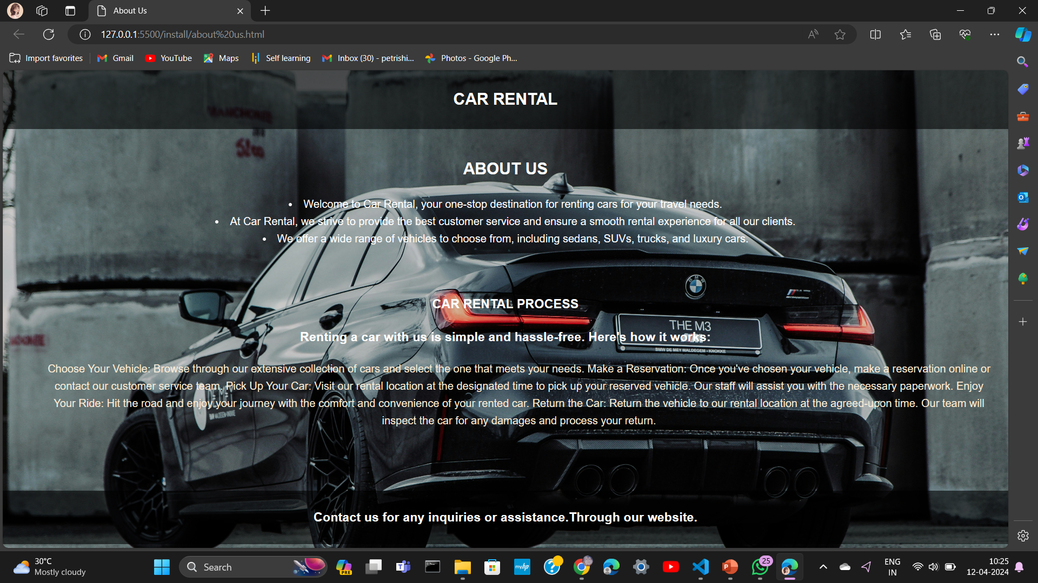
About-Us-Page

Slide 13
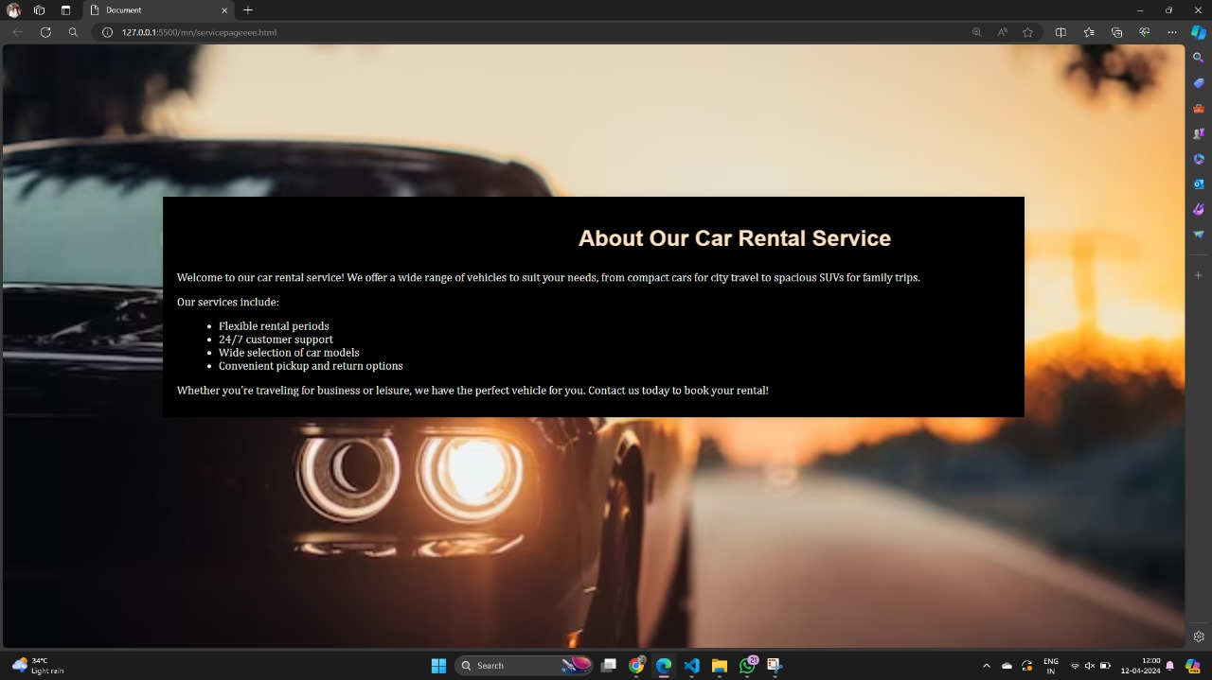
Service-Page

Slide 14
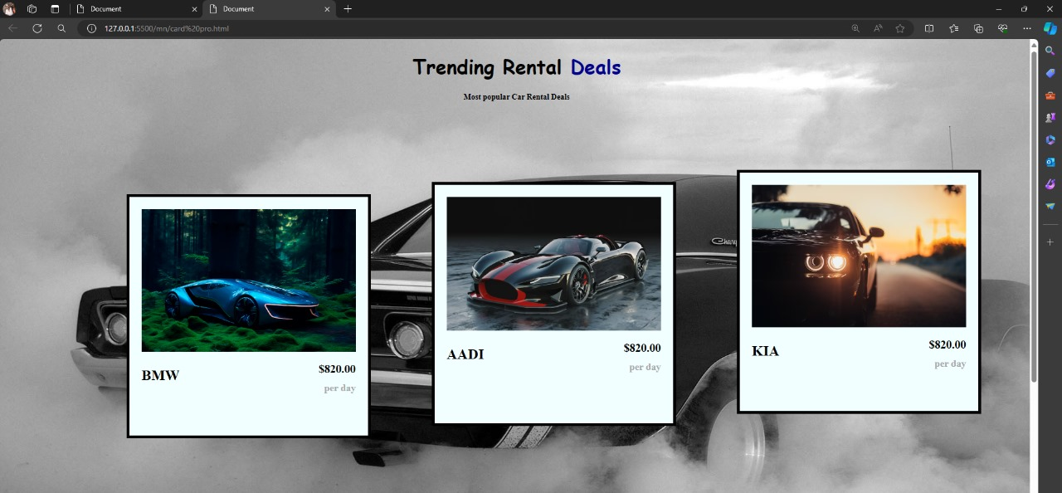
Departments-Page

Slide 15
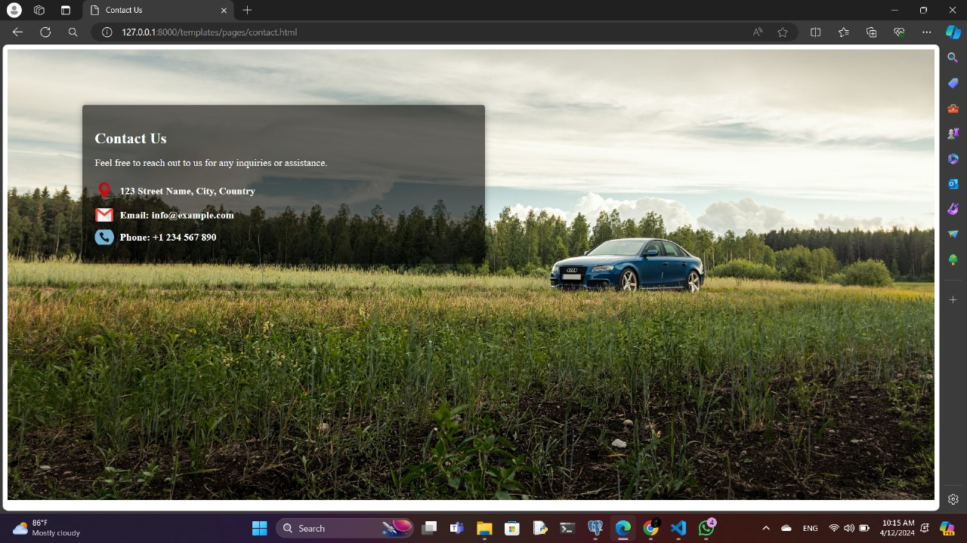
Blog-Page

Slide 16
Future Enhancements:
Implementing AI-driven recommendation systems for personalized car suggestions based on user preferences and past rentals.
Integrating real-time GPS tracking for accurate vehicle location and easier navigation for both customers and rental operators.
Introducing a seamless mobile app for convenient booking, payment, and communication with customers, enhancing accessibility and user experience.
Incorporating a dynamic pricing model that adjusts rental rates based on demand, availability, and other factors, maximizing revenue and optimizing utilization.
Enhancing security measures with biometric authentication options and fraud detection algorithms to ensure safe transactions and protect customer data.
Developing predictive maintenance algorithms to anticipate and prevent potential vehicle issues, minimizing downtime and improving fleet reliability.
Introducing eco-friendly vehicle options and promoting sustainability initiatives, appealing to environmentally conscious customers and reducing carbon footprint.
Expanding partnerships with local businesses for exclusive discounts and offers, enriching the customer experience and fostering community engagement.
Implementing advanced analytics tools to gain insights into customer behavior, market trends, and operational efficiency, enabling data-driven decision-making and continuous improvement.
Providing multilingual support and localization features to cater to a diverse customer base, enhancing inclusivity and accessibility of the platform

Slide 17
Conclusion In conclusion, the Django framework offers a robust foundation for building a car rentals application, providing scalability, security, and flexibility. Leveraging Django's powerful features like ORM, authentication, and built-in admin interface streamlines development and maintenance. With Django, developers can create a user-friendly, efficient, and reliable car rentals platform tailored to specific business needs, ensuring a seamless experience for both customers and administrators.
Source :

Slide 18
Thank You!
Notes:
Thank You !!

